Slide 1
Data Analysis of Facebook records
Data from Facebook pages of company VICE

Slide 2
Main questions
How was the content strategy of Vice on Facebook changed over time?
Does all types of engagement (reactions on FB post: love, wow, sad, angry etc.) appear equally often on very popular vs. not so popular posts?
What word combinations appear on popular posts vs. unpopular posts?
The FB data are available for period from 26/05/2018 till 25/05/2021, so 3 years.

Slide 3
Summary of Vice's content strategy
The vast majority of posts on Vice FB pages are reposted (86 % of total) and only small number of post are original (13 %).
On average posts are usually published on Thursdays, Wednesdays and Tuesdays, the most often after 12:00, from 14:00 till 16:59 and from 20:00 till 21:59.
During the year the most posts are published in November and December.
Only 1 % of all posts were sponsored. The main sponsors came from car industry. It was mostly posts sponsored by Cadillac company.
Majority of the video length is around 3 minutes or less than 1 minute. Median value of video length is 4 minutes, average is 5,6 minutes.

Slide 4
How did content strategy changed over 3 years?
Three years cover period from 26th may 2018 to 25th may 2021 and are divided into 3 equally long periods.
decrease of number of posts in last 2 years (6819 posts in second period, but only 5031 posts in last period)
longer videos (on average from 4,5 minutes in first period to 7 minutes of video in last period)
decrease of number of crossposts and increase number of original posts in last 2 years
no change in share of sponsored posts, they represent only 1 % of all posts. In last period it is even only 0.4 %.
total views are going up over time, even though there is significant drop in last four months.

Slide 5
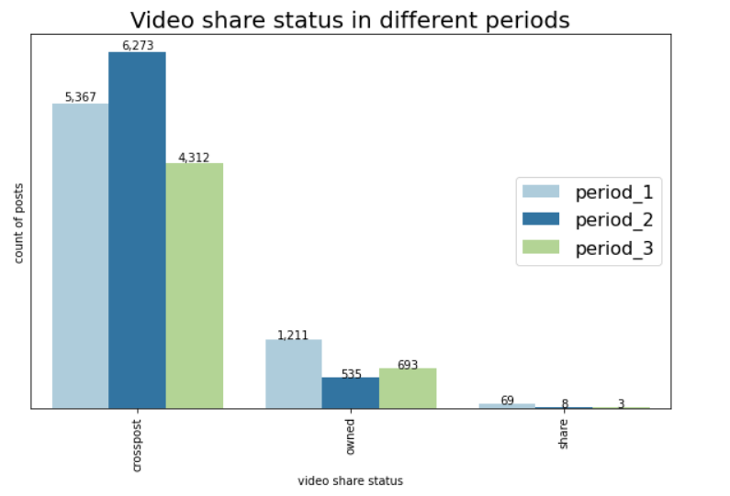
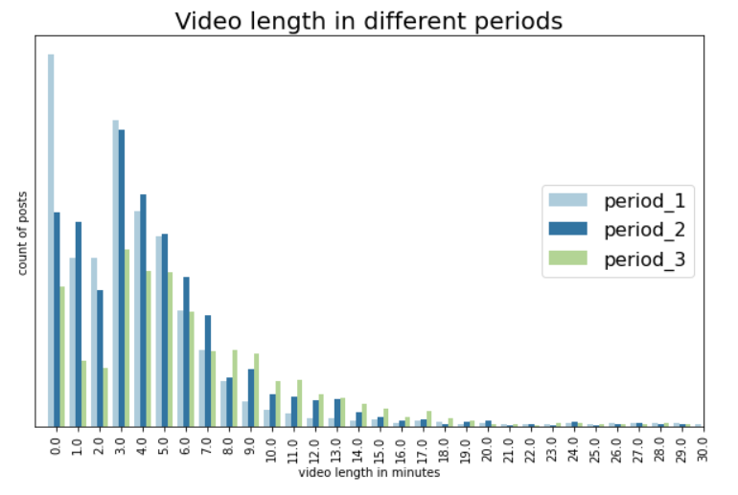
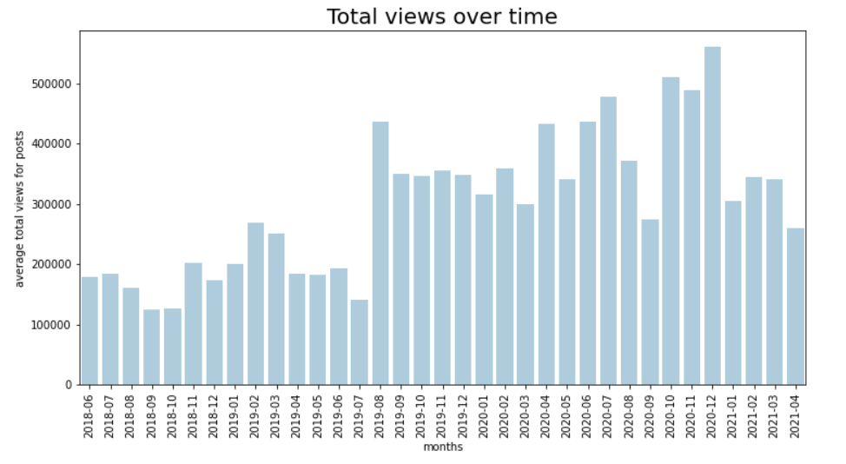

Slide 6
FB reactions on popular vs unpopular posts
Higher popularity of posts (in terms of total interactions), more often haha reaction appears.
Higher popularity of posts, more often wow reaction appears.
Sad reaction appears more often on less popular posts
Love reaction appears more or less similarily often on all posts with slightly higher ratio of love on totally popular posts.
Angry reaction does appear less on the best and the worst posts, but more on average posts in terms of total interactions

Slide 7
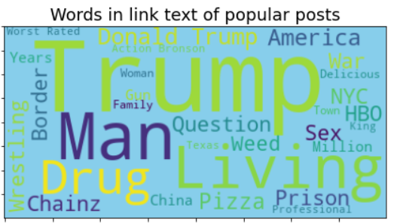
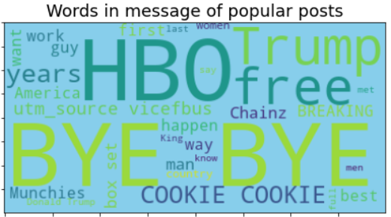
Words + word combinations on popular posts

Slide 8
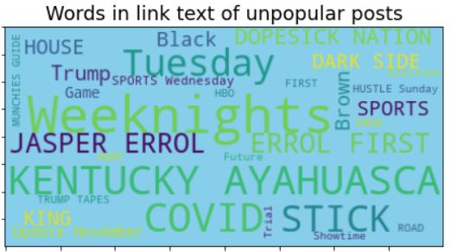
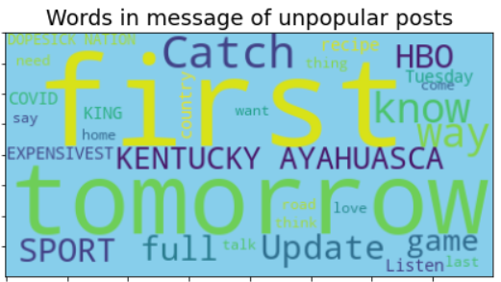
Words + word combinations on unpopular posts

